Slide 1
ARGUS
The right care, in the right place, at the right time

Slide 2
Problem
Patients seeking out primary care visit the inappropriate healthcare center during unsuitable times according to their condition and the occupancy of the healthcare facilities.

Slide 3
Problem
Choice of
Healthcare
Center
03
Illness
or
Injury
01
02
Acuity
Evaluation

Slide 4
Problem
Acuity Evaluation
1
Self Diagnosis
2
Info-Santé 811
Intrinsic Bias
Unreliable
Inaccurate
Dangerous
Inaccurate
Voice Call
Lack of Patient Data
Human Bias
Restricted resources

Slide 5
Problem
Choice of Healthcare Center
1
Patient Choice
2
Info-Santé 811
Poor choice
Not specific
Suboptimal
Lack of knowledge of available resources
Lack of knowledge of occupancy of healthcare centers
Based on poor and inaccurate severity evaluation
Lack of real time data indicating hospital occupancy
Lack of direct contact with healthcare center
Human bias

Slide 6
Problem
Consequences
Inaccurate patient evaluations that may result in increased severity and mortality rate
Suboptimal patient distribution across the health network
Costly patient transfers and redirections
Increase in LWBS patients
Overcrowding and increased waiting times in various healthcare centers
Overworked physicians and understaffing issues
We are unable to provide the right care, in the right place, at the right time

Slide 7
Solution
Artificial intelligent algorithms can be trained on unlimited amounts of data to accurately evaluate patient acuity and direct patients to the appropriate resource, at the ideal time, to receive the optimal care based on their condition and the occupancy of the healthcare facilities.

Slide 8
Solution
3
Artificial Intelligence
A
Acuity Evaluation
B
Choice of Healthcare center
Access to larger amounts of patient data (historical and real time)
Very accurate - AI trained on unlimited amount of triage data
No human bias - Standard evaluation
Instantaneous service and feedback - No delay
Vital sign sensors can be used for triage re-evaluation and monitoring
Access to real-time data from network of healthcare centers indicating occupancy and other significant variables
No human bias
Optimal patient distribution
Optimal time of consultation
Direct contact with healthcare centers

Slide 9
Solution
Benefits
Reliable patient evaluations that accurately determine patient severity and acuity
Optimized patient distribution across the health network
Decrease in patient redirections and transfers
Decrease in LWBS patients and hospital overcrowding
Patients visit the right healthcare centers at the right time according to their specific symptoms & acuity while considering facility occupancy and available resources
Optimized patient flow and reduced waiting times at walk-in clinics and the ER
Balanced physician workloads and improved staffing
We are able to provide the right care, in the right place, at the right time

Slide 10



Team
Stephen Lu
Om Agarwal
Justin Lacoste
Student researcher at SickKids
Founder of Emergence A.I.
CWSF Silver Medallist
WInner of Hydro-Quebec provincial science-fair
Recipient of Youth Can Innovate
5x CWSF alumni
CWSF Gold Medallist
TEDx speaker
2 ML/AI publications
Created VitSys - Vital Signs Interconnected Triage Device

Slide 11


The Story

Slide 12
Our Product
Acuity assignment
With the triage, historical and real-time patient data, assign an acuity/severity score to the patient that will reliably indicate the intensity of physician care and the time frame needed to provide it.
Symptoms
The patient inputs all his apparent symptoms from a list of comprehensive symptoms recognized by the triage algorithm.
04
01
03
Medical Data
Using historical patient data such as past appointments, medical history and medication as well as real-time patient data like emotion recognition, heart rate and other vital signs, improve the accuracy of the acuity diagnostic and the adequate response.
Triage
According to the inputted symptoms, the AI asks a series of comprehensive questions to target the appropriate acuity and response.
02

Slide 13
Our Product
Argus
E.R.
Clinics
Patient
GMF
CLSC

Slide 14
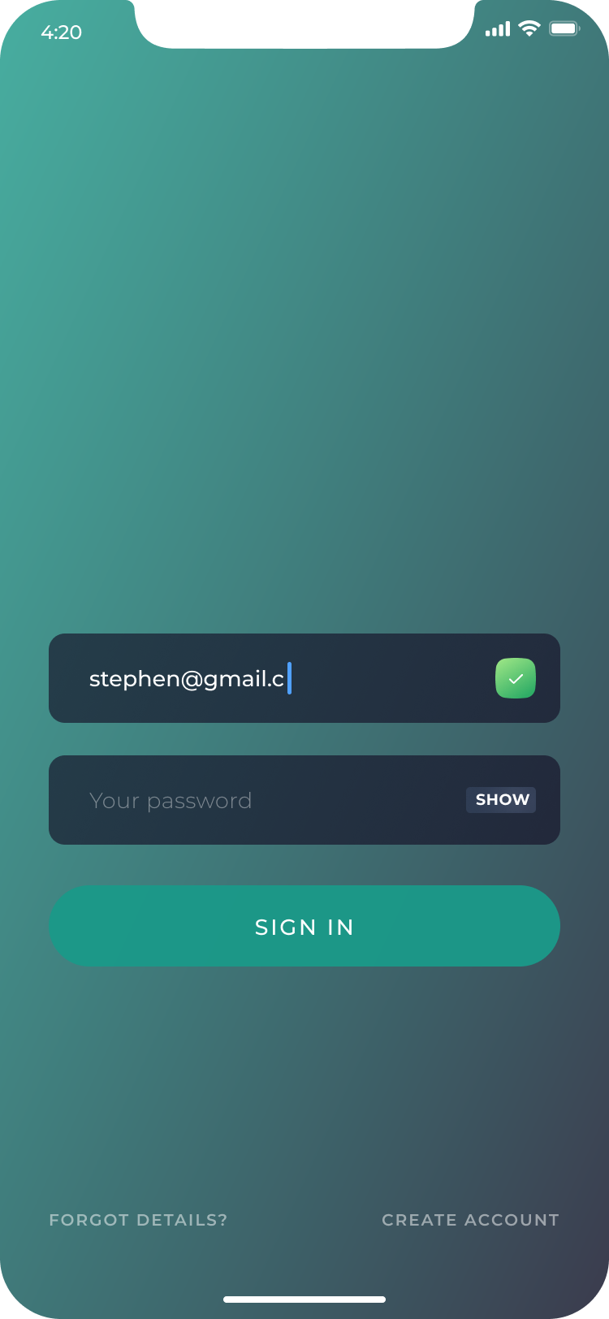
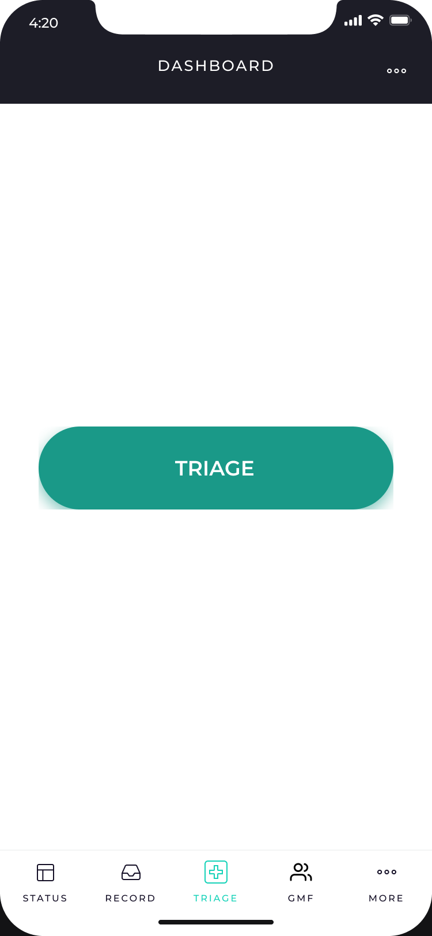
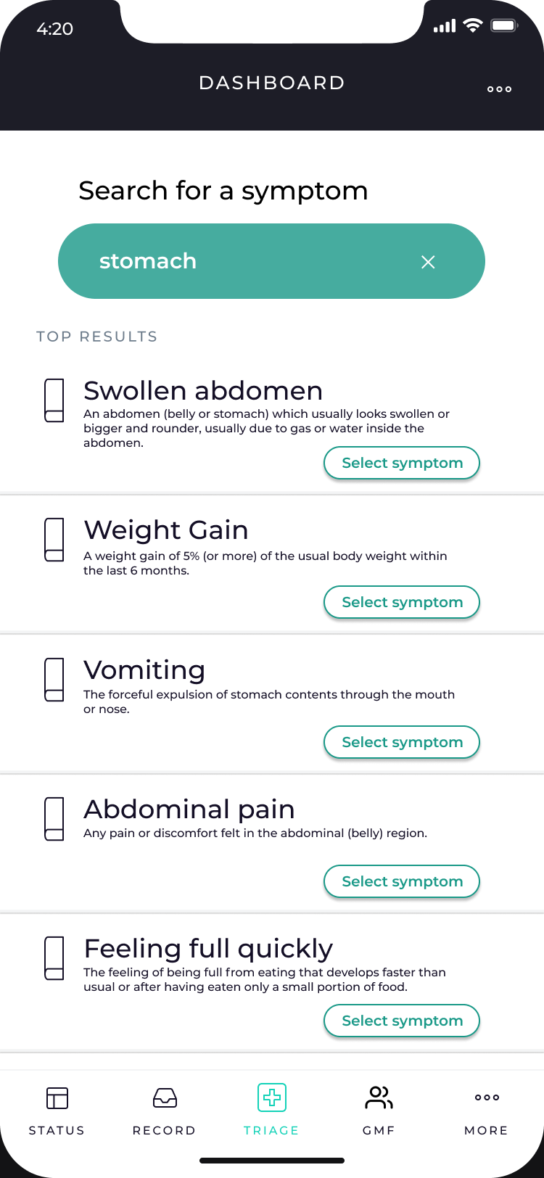
Our Product
ARGUS

Slide 15
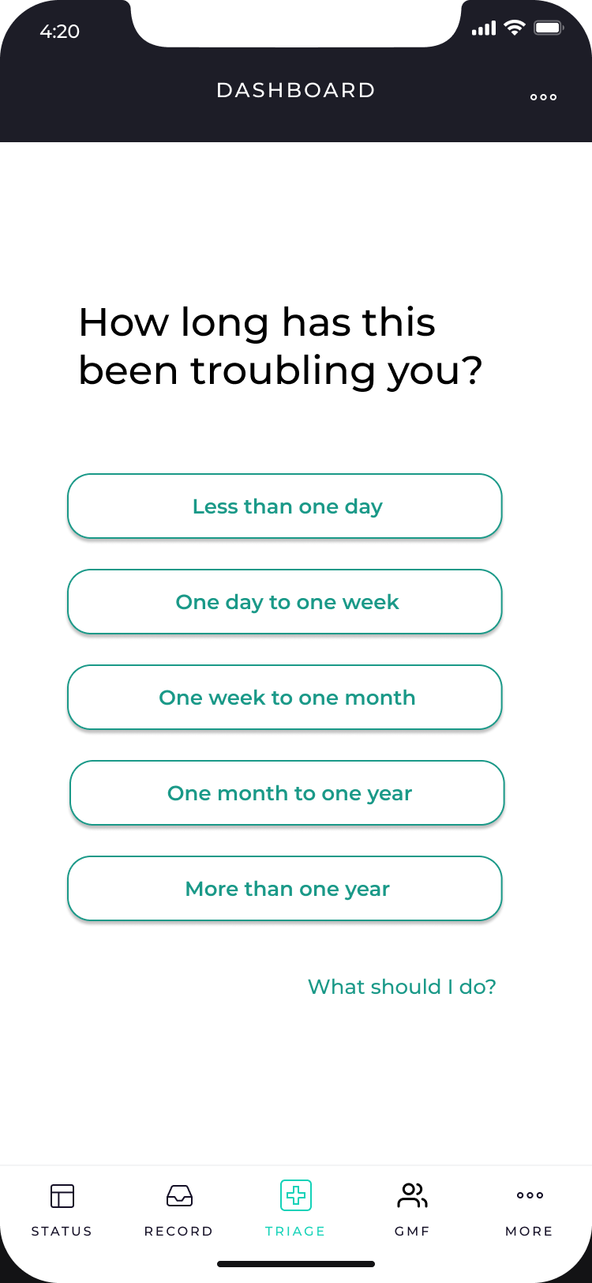
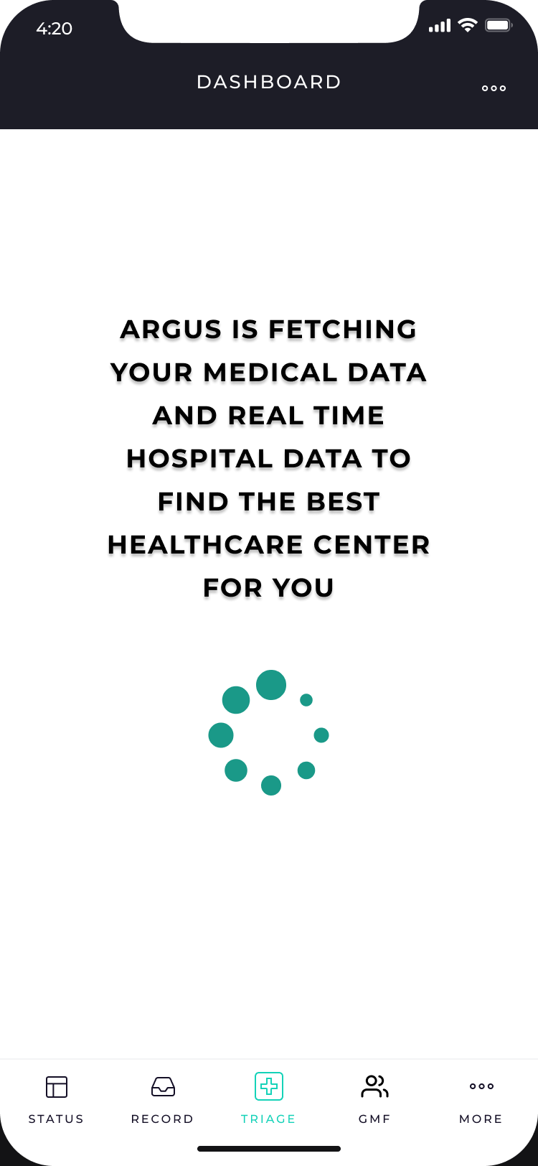
Our Product

Slide 16
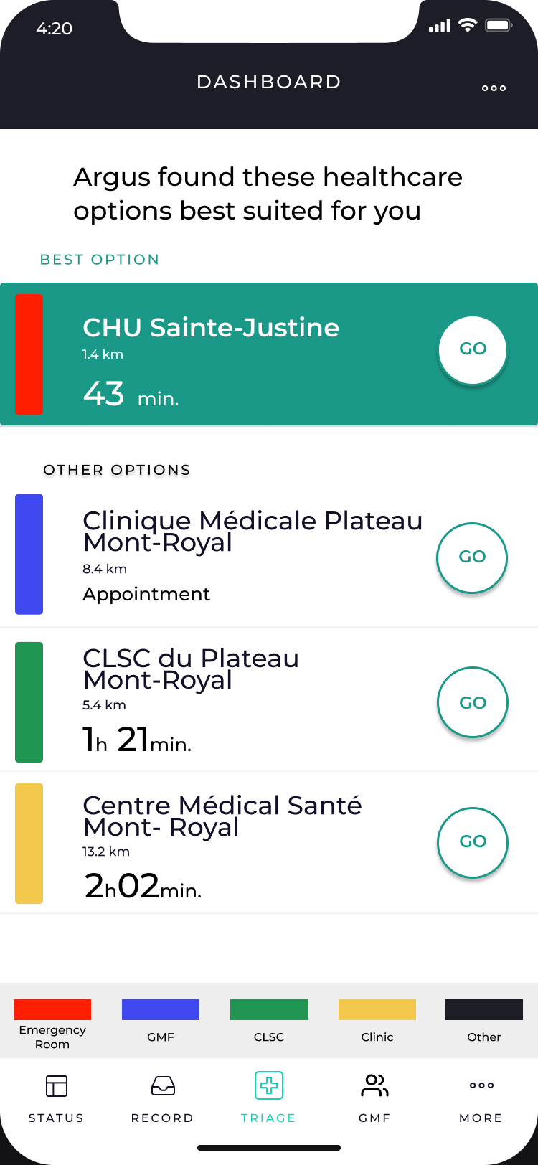
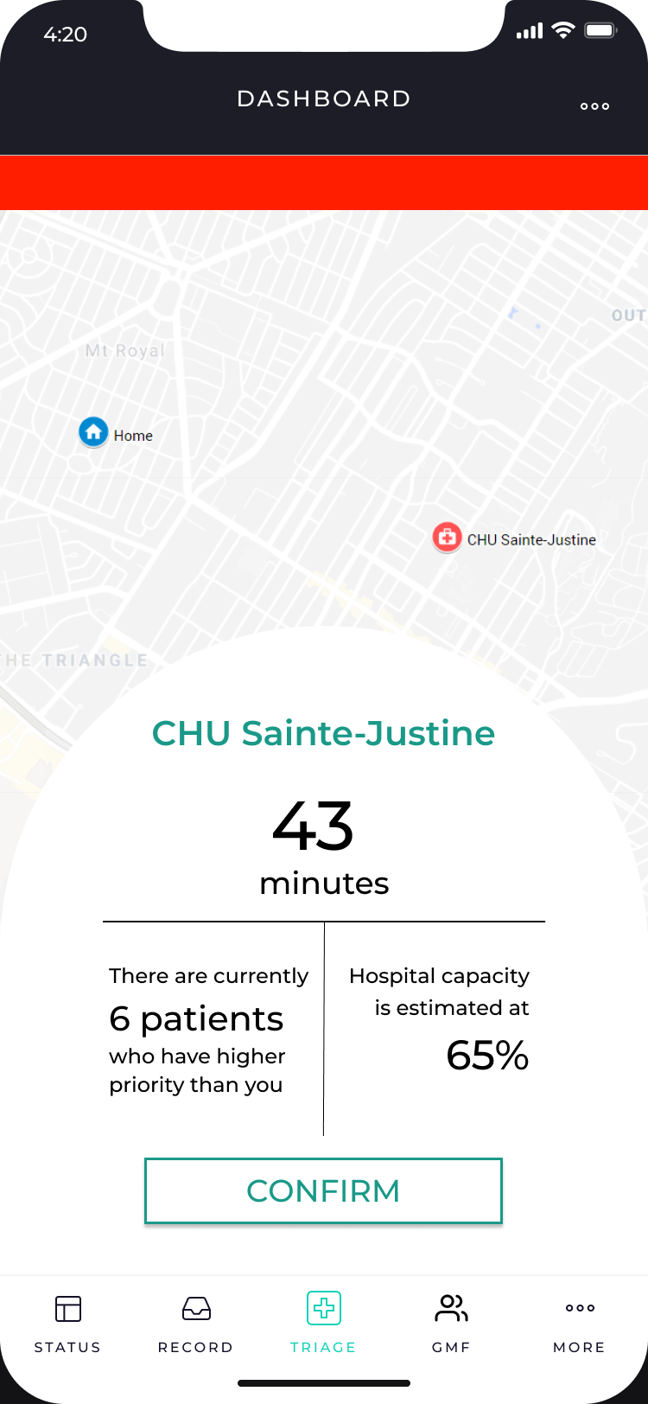
Our Product

Slide 17
Market Validation

Slide 18
What do we need from you?
Patient triage/diagnosis data | Real time hospital data | Medical expertise
Triage symptoms Medical condition Medical history Consultation history Triage acuity (I to V) Vital signs/quantitative data Age Sexe Address | Treatment capacity Number of available beds Physicians on shift Patients in the waiting room Patients in consultation All patients acuity Active shifts Triage assessment protocol (questions) | Experienced triage nurse to go through effective triage protocol and complete factors that influence patient acuity and severity Experienced administrator that knows the factors that influence hospital occupancy and treatment capacity Data analyst or scientist that is familiar with hospital data structure

Slide 19
A medical stigma with A.I.?

